Slide 1
Employer Assessment
Indicator Description, Methodology and Results
28.08.2026

Slide 2
Employer Assessment
INDICATOR DESCRIPTION
Employer assessment is characterised by two complementary indicators: the external PRAKSE.LV assessment and the results of the RISEBA Employer Survey.
INDICATOR
WHAT IT MEASURES
ASSESSMENT CRITERION / TARGET
PRAKSE.LV
assessment
External employer assessment of higher education institutions.
TOP 3
among higher education institutions founded by legal entities
Employer Survey
results
Employers’ assessment of whether RISEBA prepares specialists who meet the needs of the labour market and industry development.
≥80%
of respondents selected “Strongly Agree / Yes” or “Rather Agree / Rather, yes”
ASSESSMENT APPROACH • External employer assessment and the RISEBA Employer Survey.
Indicator relevance: The PRAKSE.LV ranking reflects RISEBA’s standing among employers, while the survey KPI reflects employers’ assessment of whether RISEBA prepares specialists who meet the needs of the labour market and industry development.

Slide 3
PRAKSE.LV Employer Assessment
EXTERNAL EMPLOYER PERCEPTION INDICATOR
INDICATOR RELEVANCE
Prakse.lv, in cooperation with the Employers’ Confederation of Latvia (LDDK), compiles the ranking of higher education institutions and study programmes most recommended by employers. The result reflects employers’ confidence in RISEBA and provides an external assessment of its graduates’ preparedness.
7th place
167
2nd place
in the overall ranking
employer recommendations
among higher education institutions founded by ownership category
DATA AVAILABILITY AND COMPARABILITY
Written confirmation from Prakse.lv confirms that RISEBA has maintained 7th place in the overall ranking over the past three years. This reflects its overall position; RISEBA’s Top 3 target is assessed separately among higher education institutions founded by ownership category. Annual recommendation counts were not retained; therefore, a complete numerical trend is not currently available.
RISEBA TARGET
TOP 3
among higher education institutions founded by ownership category
ACHIEVED • 2ND PLACE
FUTURE MONITORING
RISEBA will record annually the date, overall ranking position, number of employer recommendations and position among higher education institutions founded by ownership category.

Slide 4
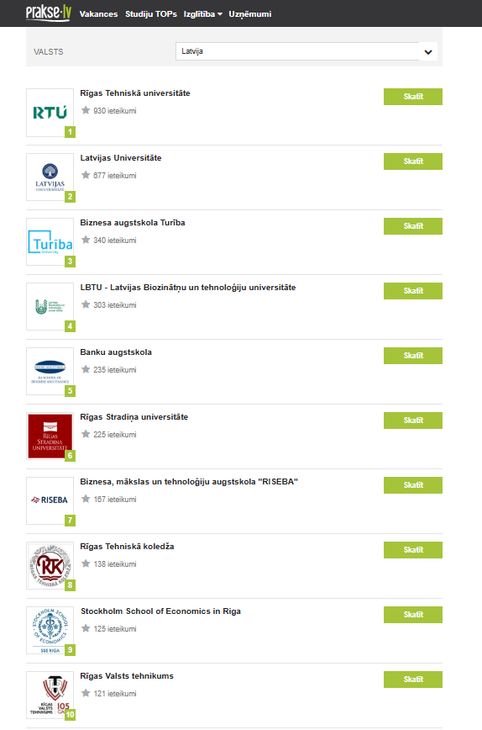
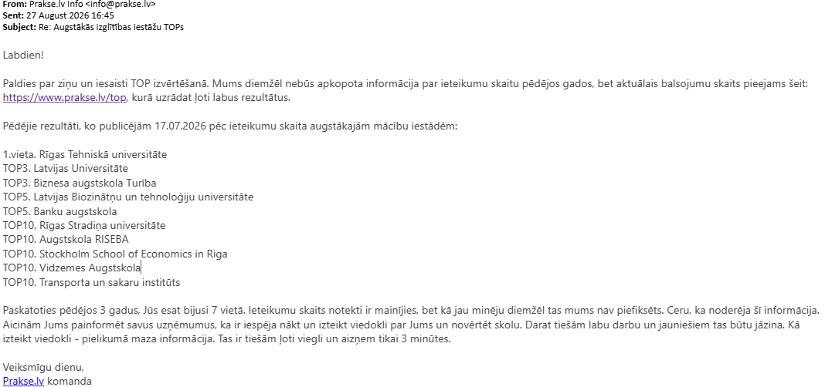
Evidence Supporting the PRAKSE.LV Indicator
PUBLICLY AVAILABLE INFORMATION AND PRAKSE.LV CONFIRMATION
PRAKSE.LV RANKING (17.07.2026) and Supplementary Data Analysis
Overall Rank | Rank among Private HEIs | Higher Education Institution (HEI) | Employer Recommendations | Ownership
1 |  | Riga Technical University | 460 | Public
2 |  | University of Latvia | 429 | Public
3 | 1 | Turība University | 341 | Private
4 |  | Latvia University of Life Sciences and Technologies | 206 | Public
5 |  | Bank School | 203 | Public
6 |  | Rīga Stradiņš University | 183 | Public
7 | 2 | RISEBA University of Applied Sciences | 167 | Private
8 |  | Art Academy of Latvia | 100 | Public
9 | 3 | Stockholm School of Economics in Riga | 90 | Private
10 |  | Vidzeme University of Applied Sciences | 89 | Public
Original source materials are available in Latvian only. The accompanying table was prepared by RISEBA based on publicly available data and supplemented with higher education institution ownership categories.
PRAKSE.LV EMAIL SCREENSHOT CONFIRMING RISEBA’s 7th place in the overall ranking over the past three years
Original source materials are available in Latvian only. The email confirmation from Prakse.lv that RISEBA has maintained 7th place in the overall ranking over the past three years. Although the number of employer recommendations has varied, the annual figures were not recorded by Prakse.lv.

Slide 5
Employer Survey results
REGULAR MONITORING OF EMPLOYER ASSESSMENT
SURVEY PURPOSE
The Employer Survey provides systematic feedback on how well the professional competencies of RISEBA graduates and students meet labour market and industry development needs.
Once every 3 years
2023
2026
regular institution-wide survey
latest RISEBA-wide measurement
next regular survey
2023 • BASELINE
The direct KPI question had not yet been included; therefore, the overall RISEBA result is assessed using the 16 competency statements evaluated by employers.
2025 • ADDITIONAL MEASUREMENT
2025 • SURVEY ENHANCEMENT
For the purposes of national accreditation, an additional Employer Survey was conducted for the Arts study, using the same 16 competency statements.
The survey questions were reviewed and updated, and a single KPI question was added:
“Do you think RISEBA prepares specialists who meet the needs of the labour market and industry development?”
ASSESSMENT SCALES
16 COMPETENCY STATEMENTS
1 - Disagree
2 - Rather Disagree
3 - Rather Agree
4 - Agree
5 - Not Applicable to my Company
DIRECT KPI QUESTION
1 - Yes
2 - Rather, yes
3 - Rather, no
4 - No
5 - I can't answer it
2023 regular Employer Survey
2025 additional Employer Survey
2025 additional Employer Survey
2026 regular Employer Survey
Positive assessment: Rather agree + Agree
Positive assessment: Yes + Rather, yes
FUTURE MONITORING
The direct KPI question is planned for use in the regular 2026 Employer Survey as the key employer assessment KPI.
RISEBA TARGET
≥ 80% “Yes” + “Rather, yes”

Slide 6
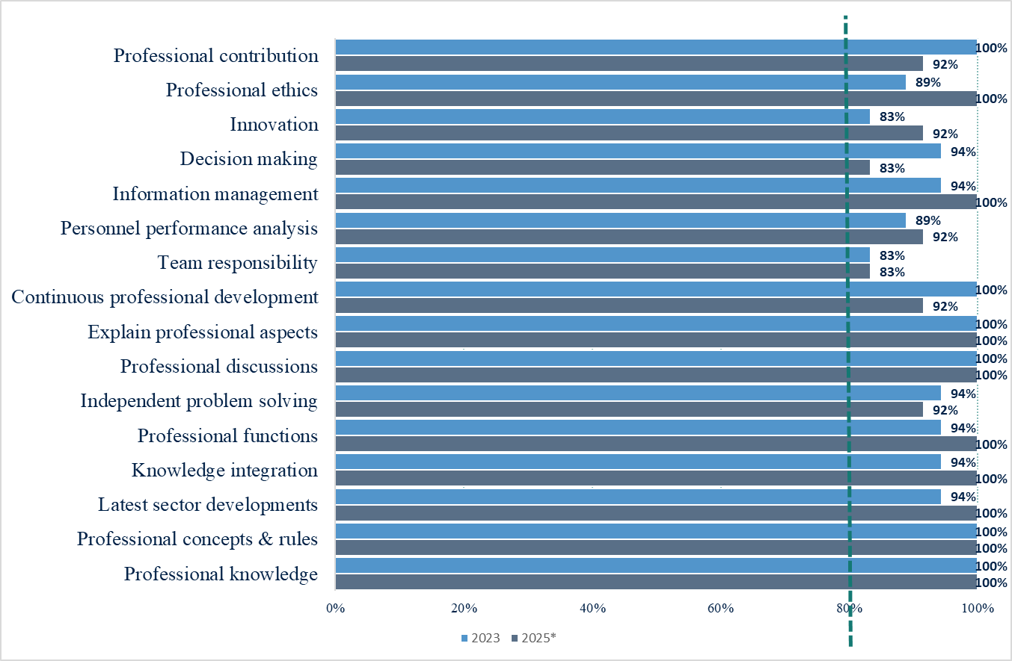
Employer Survey Results
EMPLOYER ASSESSMENT OF RISEBA GRADUATES
MEASUREMENT BASIS
Employers assessed 16 competency statements in response to the question: “Please indicate to what extent the below statements apply to RISEBA graduates.” The chart shows shortened statement labels; the full wording of all 16 statements is provided in the appendix.
2023 • RISEBA-WIDE SURVEY
Regular institution-wide Employer Survey.
The 2023 results represent the overall RISEBA employer assessment and serve as the current institutional baseline.
2025* • ADDITIONAL SURVEY
Additional Employer Survey for the Arts study field (n=20), conducted for national accreditation purposes.
The same 16 competency statements were used; the results are therefore shown as supplementary evidence.
KEY RESULT
All 16 competency areas reached or exceeded the 80% target.
* 2025 results relate only to the Arts study field and are not an institution-wide RISEBA measurement.

Slide 7
Employer Survey Results
DIRECT KPI QUESTION • 2025 ARTS STUDY FIELD
MEASUREMENT
As part of the additional Employer Survey for the Arts study field, conducted for national accreditation purposes, employers were asked a direct question on whether RISEBA prepares specialists who meet labour market and industry development needs.
DIRECT KPI QUESTION
“Do you think RISEBA is preparing specialists suitable for the development of the labour market and industry?”
RESULT
100%
Target ≥ 80%
CALCULATION
Positive assessment =
“Yes” + “Rather, yes”
(12 of 12 valid responses)
INTERPRETATION
The result exceeds the RISEBA target by 20 percentage points.
* 2025 result relates to the additional Arts study field survey and is not an institution-wide RISEBA measurement.

